Slide 1

What is Deep learning? Perceptrons and multiple layers

Slide 2
Formal definition of deep learning
“ Deep learning is a subfield of machine learning: a new take on learning representations from data that puts an emphasis on learning successive layers of increasingly meaningful representations.” - Francois Cholet
How is this different from the type of learning we have been doing so far? In machine learning we had i) Input data points ii) expected outputs iii) a measure of error - aka, distance between our predicted outputs and correct outputs
The learning task here was to search for meaningful representations of some input data, within a predefined space of possibilities (dimension) using guidance from a feedback signal (Error).
What’s a representation? At its core, it’s a different way to look at data—to represent or encode data. For instance, a color image can be encoded in the RGB format (red-green-blue) or in the HSV format (hue-saturation-value): these are two different representations of the same data.

Slide 3
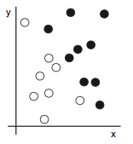
Machine Learning: 10,000ft view
Consider an x-axis, a y-axis, and some points represented by their coordinates in the (x, y)
We want to develop a decsion making system that can take the coordinates (x, y) of a point and output whether that point is likely to be black or to be white.
What we need here is a new representation of our data that cleanly separates the white points from the black points (think SVM)
Notes:
The inputs are the coordinates of our points. The expected outputs are the colors of our points. A way to measure whether our algorithm is doing a good job could be, for instance, the percentage of points that are being correctly classified.

Slide 4
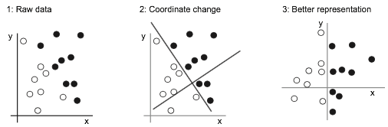
Machine Learning: 10,00ft view
So, what happened here? We systematically searched for different possible coordinate changes, and used as feedback the percentage of points being correctly classified. Learning, in the context of machine learning, describes an automatic search process for better representations.
Notes:
hese opera- tions can be coordinate changes, as you just saw, or linear projections (which may destroy information), translations, nonlinear operations (such as “select all points such that x > 0”), and so on.

Slide 5
If that is learning in machine learning, what is ‘deep’?
As we described earlier, deep learning is a process of ‘learning successive layers of increasingly meaningful representations’.
The ‘deep’ in deep learning isn’t a reference to any kind of deeper understanding achieved by the approach; rather, it stands for this idea of suc- cessive layers of representations.
In deep learning, these layered representations are learned via models called neural networks.

Slide 6
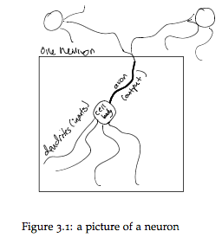
Neural Networks: Inspired by the brain?
Our brains are made up of little units, called neurons, that send electrical signals to one another. The rate of firing tells us how “activated” a neuron is. A single neuron, like that shown below might have two incoming neurons.
These incoming neurons are firing at different rates (i.e., have different activations). Based on how much these incoming neurons are firing, and how “strong” the neural connections are, our main neuron will “decide” how strongly it wants to fire

Slide 7
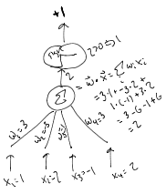
A Closer Look
We are going to think of our learning algorithm as a single neuron. It receives input from D-many other neurons, one for each input feature.
The strength of these inputs are the feature values (like beta values). This is shown schematically in the Figure. Each incoming connection has a weight and the neuron simply sums up all the weighted inputs. Based on this sum, it decides whether to “fire” or

Slide 8
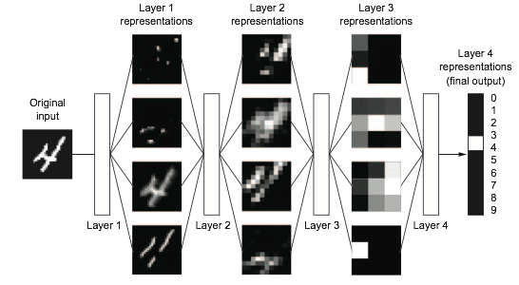
Multi-layer representations
What we saw is called the “perceptron” model, it is a single layer neural network. We have input x → data transformation → output.
In deep learning,we have multiple layers. Here is an example of one:

Slide 9
What did we see?
The network transforms the digit image into representations that are increasingly different from the original image and increasingly informative about the final result. So, deep learning here is a multistage information-distillation operation, where information goes through successive filters and comes out increasingly purified (that is, useful with regard to some task).
The question now is, how do we get our first representation and subsequent ones? Lets look at how this is done concretely.

Slide 10
Data Transformations
The specification of what a layer does to its input data is stored in the layer’s weights, which in essence are a bunch of numbers (think of log-transformations for example)
In this context, learning means finding a set of values for the weights of all layers in a network, such that the network will correctly map example inputs to their associated targets.
But here’s the thing: a deep neural network can contain tens of millions of parameters. Finding the correct value for all of them may seem like a daunting task.

Slide 11
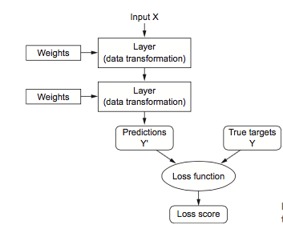
How to estimate the weights?
To know how closer or far our selection of weights gets us to our true answer, we must have a measure for error.
The loss function takes the predictions of the network and the true target and computes a distance score, capturing how well the network has done.

Slide 12
How to estimate weights?
The trick in deep learning is to use this score as a feedback signal to adjust the value of the weights in a direction that will lower the loss score. This adjustment is the job of the optimizer, which implements what’s called the Backpropagation algorithm: the central algorithm in deep learning.
With every example the network processes, the weights are adjusted a little in the correct direction, and the loss score decreases.This is the training loop, which, typically tens of iterations over thousands of examples, yields weight values that minimize the loss function.

Slide 13
Example with Single layer n. network (perceptron)
We are going to think of our learning algorithm as a single neuron. It receives input from D-many other neurons, one for each input feature.
The strength of these inputs are the feature values (like beta values). This is shown schematically in the Figure. Each incoming connection has a weight and the neuron simply sums up all the weighted inputs on the hidden unit. Based on this sum, it decides whether to “fire” or not.

Slide 14

Example with Single layer n. network (perceptron)
If the weighted sum is positive, it “fires” and otherwise it doesn’t fire.This can be formalized by
“a” computes the activation.If this activation is positive (i.e., a > 0) it predicts that this example is a positive example. Otherwise it predicts a negative example.
It is often convenient to have a non-zero threshold. In other words, we might want to predict positive if a > q for some value q. The way that is most convenient to achieve this is to introduce a bias term into the neuron, so that the activation is always increased by some fixed value b.
The perceptron computes a non-linear function of their inputs for the hidden layer. This is usually called the activation function. A popular activation function is the sigmoid function. Yes, this is our old friend the logistic function.

Slide 15
Optimization for a single layer neural network
So, in this way, the Perceptron is a classification algorithm for problems with two classes (0 and 1) where a linear equation (like or hyperplane) can be used to separate the two classes.
But how do we compute the aforementioned weights? Stochastic Gradient Descent.
Specifically, w(t+1)= w(t) + learning_rate * (expected(t) - predicted(t)) * x(t)
The bias is calculated similarly. bias(t+1) = bias(t) + learning_rate * (expected(t) - predicted(t)).
Lets work through an example by hand

Slide 16
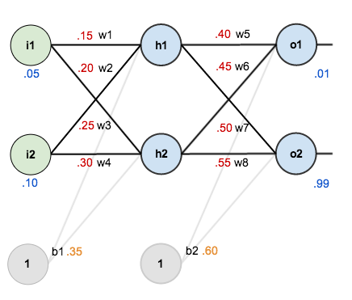
Assume these initial input values and weights

Slide 17
Steps
Step 1: Calculate activation on hidden layer 1
Step 2: Squash it using the logistic function
Doing the same for hidden layer 2 we get,
Step 3: Calculate input to final layer
Step 4: Calculate error. Error on 01 =

Slide 18

Weight updation
Step 5: Update ALL weights. Lets start with w_{5 .} By the chain rule we know
So, the question we are asking here is how does change in weights affect the output.
First part

Slide 19
Weight updation
Second part - This part is about how the output changes with respect to input layer activation
The third part - how much does the total net input of o1 change with respect to w5?

Slide 20
Putting it all together
Now we have what we need to update weight

Slide 21
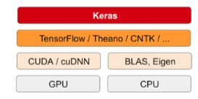
What is Keras?
Keras is a deep-learning framework for Python that provides a convenient way to define and train almost any kind of deep-learning model.
It has built-in support for convolutional networks (for computer vision), recur- rent networks (for sequence processing), and any combination of both.
Keras is a model-level library, providing high-level building blocks for developing deep-learning models. It doesn’t handle low-level operations such as tensor manipulation and differentiation.
This is what TensorFlow is for as is Theano.

Slide 22
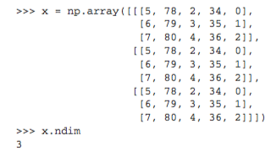
What is a Tensor?
Tensors, the data-storing objects going into the network.
tensor is a container for data—almost always numerical data.
An array of numbers is called a vector, or 1D tensor.
Below is a 3D tensor.
A tensor is defined by number of axis (3), shape (3, 3, 5), data type.

